Slide 1
Boosting Algorithm Assignment
Rezon Lambert

Slide 2
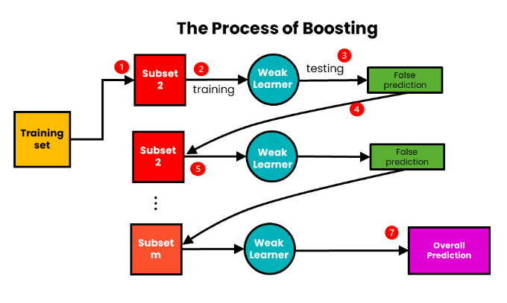
What is Boosting Algorithm?
Boosting is an Ensemble Learning method that converts a team of "weak learners" into a single "strong learner." Unlike other methods that train models independently, boosting works sequentially. Each new model focuses specifically on the mistakes (residuals) made by the previous ones. This can be used when you have a complex dataset where a single model isn't accurate enough, and you want to push for the highest possible precision.

Slide 3
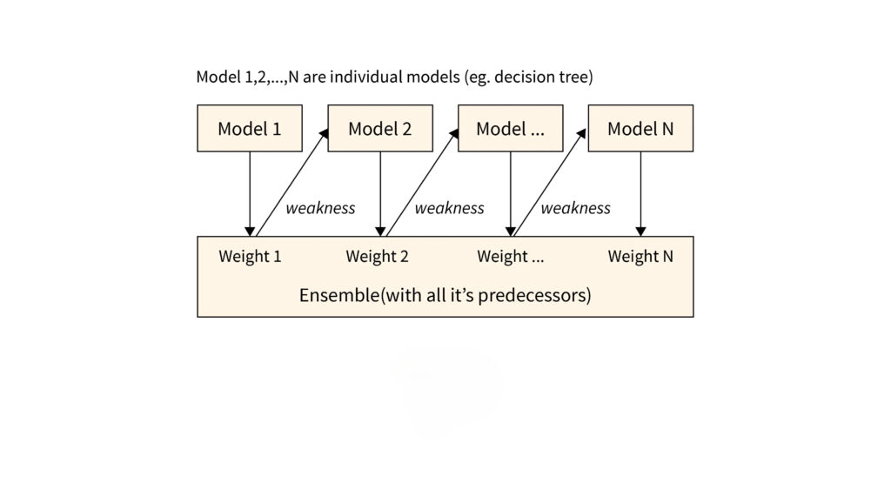
Adaptive Boosting
AdaBoost (Adaptive Boosting) assigns equal weights to all training samples initially and iteratively adjusts these weights by focusing more on misclassified data points for the next model. It effectively reduces bias and variance making it useful for classification tasks but it can be sensitive to noisy data and outliers. The pioneer of boosting. It works by reweighting data. If a data point is misclassified, its "weight" is increased so the next model pays more attention to it. Example - Face Detection: Classifying images as "Face" vs. "No Face."

Slide 4
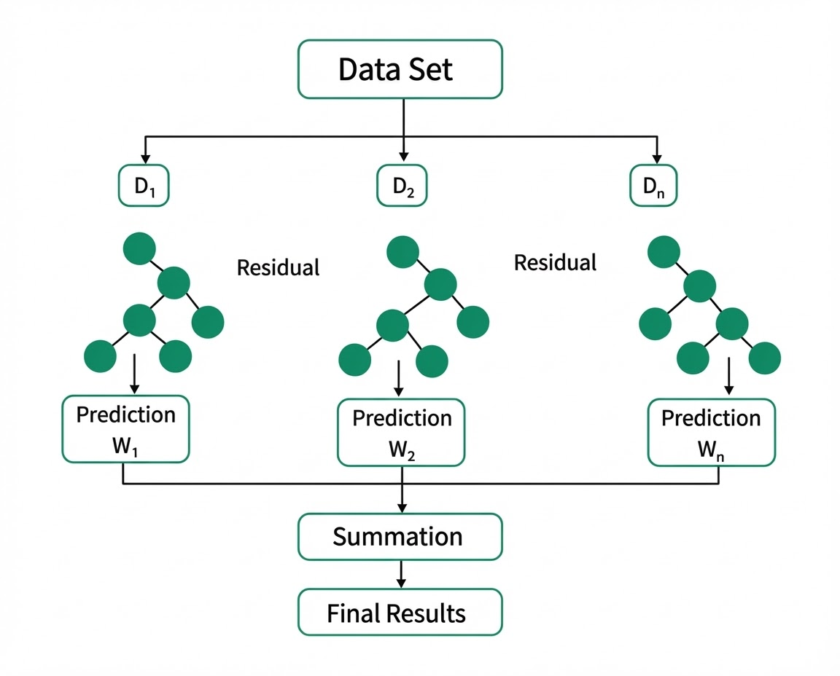
Extreme Gradient Boosting
An advanced version of Gradient Boosting built for speed and performance. It uses "Regularization" to prevent the model from becoming too complex and memorizing the data (overfitting). It builds trees level-wise (growing horizontally across each level) and uses system-level optimizations like parallel processing. Example - Predicting loan defaults or insurance claims where accuracy is critical

Slide 5
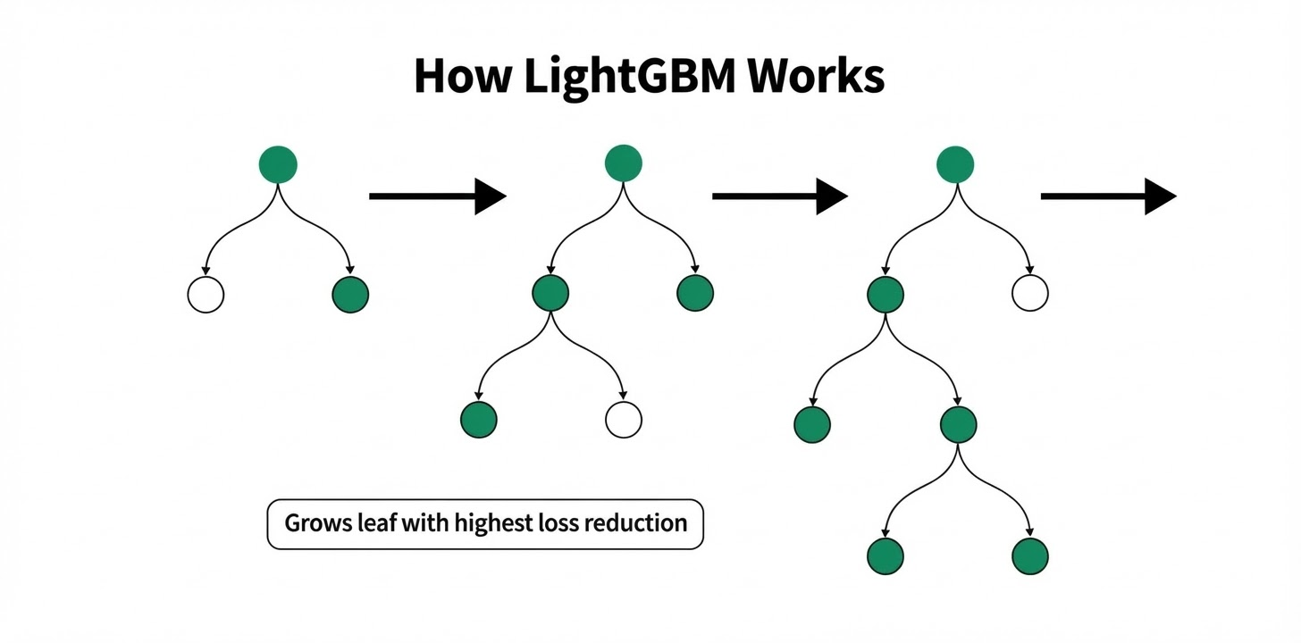
Light Gradient Boosting Machine
It grows trees leaf-wise (vertically). It picks the single most "broken" leaf and splits it further, rather than growing the whole level. This makes it much faster but requires careful tuning. It is designed to handle massive datasets with lightning speed and low memory usage. Example - Recommendation systems or search engine result ranking

Slide 6
Use Cases and Comparative Analysis
Algorithm | Strategy | Tree Growth | Best For
AdaBoost | Weighting Samples | Sequential Stumps | Simple binary classification
XGBoost | Gradient Descent | Level-wise | Medium data, high accuracy
LightGBM | Gradient Descent | Leaf Wise | Large-scale data, high speed

